Slide 1
Separation in Food

Slide 2
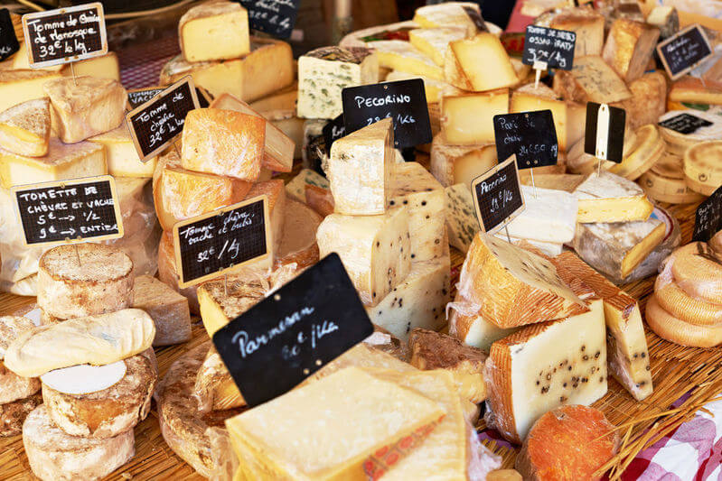
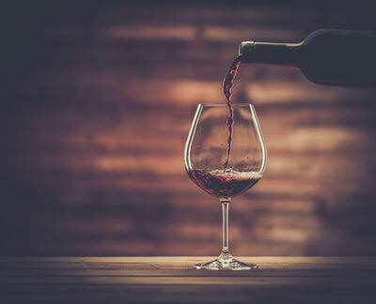
By the end of this lesson you should be able to:
Explain how milk is prepared to make it stable.
Explain how wine is created from grapes.

Slide 3
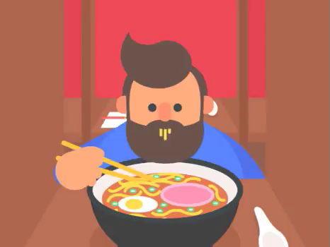
We've talked a lot about food in this module, mainly because it makes for some very good examples of mixtures.
We make and separate mixtures constantly in the kitchen.
This lesson will go through some of the mixtures you use and how they're made.

Slide 4
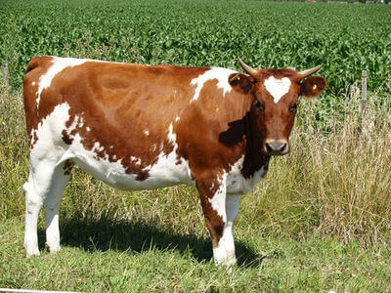
Dairy products are a type of food and drink made from milk.
Cream, butter, icecream, cheese and yogurt are all dairy products - as is milk itself.
Around the world, milk is mostly made by cows - around 85% of the world's production of milk is cow-based.
Milk comes from all mammals, however. Besides cows, we also use goats, sheep, buffalo and camels, to name a few.

Slide 5
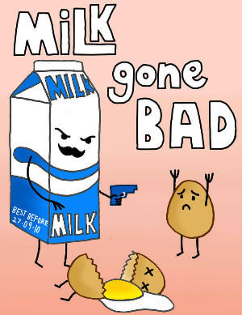
Milk, when first milked from a cow, is a mixture of two substances: watery skim milk and fatty cream.
The cream is not dissolved in the milk, but it is also not suspended as a colloid.
So if left to stand, fresh milk can very easily go off. There is a high chance that this milk contains dangerous bacteria.

Slide 6
After milking we usually separate the two components.
Skim milk is separated from the cream by centrifuge. Skim milk is heavier than cream, so the centrifuge will push it to the bottom.
We feed milk continuously into the centrifuge. The centrifuging separates the milk into layers, and each part is continuously fed out of the centrifuge to separate containers.

Slide 7
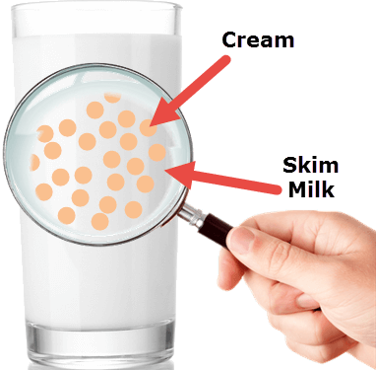
The amount of cream in milk differs from product to product.
Some is full-cream, and some has very little cream.
To make a dairy product, measured amounts of both the milk and cream parts are mixed together again to form an emulsion - a colloid made from two liquids.
In this case, cream is being suspended in the milk. Globules of cream form in the milk when mixed - but they are not yet stable.

Slide 8
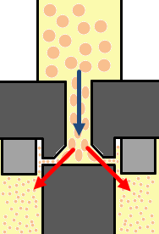
To stop the milk from going off, it is pasteurised (heated to kill bacteria) and homogenised (mixed into a colloid).
Homogenisation is the process used in the dairy industry to turn the mixed milk and cream into a colloidal suspension.
Usually this is done by forcing the milk through very small holes - this forces the blobs of cream to break down into colloidal particles.

Slide 9
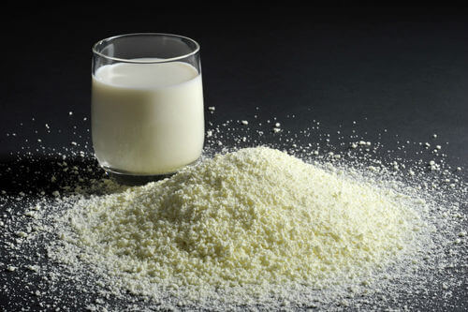
A major component of milk exports is in the form of milk powder - it is able to be stored for longer, and just requires the addition of water to drink!
We produce it through evaporation - skim milk has about half of its water content evaporated, and then a fine mist of the remaining milk is sprayed into hot air.
The hot air evaporates the water from the dissolved substances, which fall to the ground of the air chamber as the milk powder product.

Slide 10
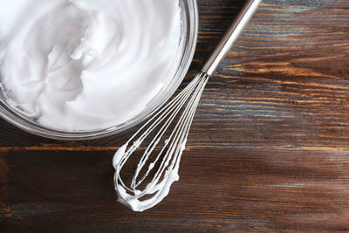
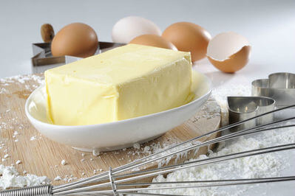
Cream is often sold as a product on its own.
Cream is high in a type of fat called butterfat, which is suspended as a colloid in water.
When stirred in air, the fat droplets capture the air, suspending it inside the cream. This creates whipped cream - a colloidal suspension of air in cream.
If stirred more, the fats begin to stick together, and water becomes suspended in fat. This colloid is known as butter!

Slide 11
You are probably not familiar with wine, but it is a useful example of a mixture.
A variety of separation techniques are used to produce wine.
Wine is an alcoholic drink made from grapes. It is created by mixing grape juice and yeast and then leaving the mixture to sit for a long time.

Slide 12
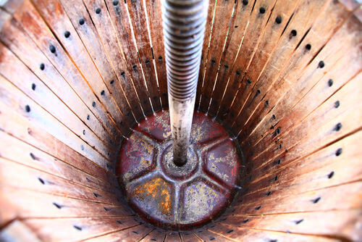
Grape juice is separated from a grape by squeezing it.
A large amount of grapes will be collected in a container, and a machine will lower a plate onto them.
The plate squishes the grapes, forcing the juice out of the skins. The juice runs out of a sluice to the side or through a sieve on the bottom of the container.

Slide 13
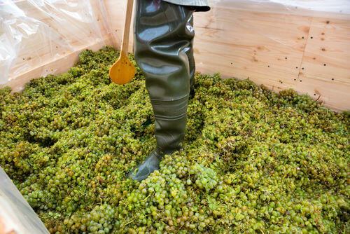
Traditionally, grapes were pressed by standing on the plate in a bucket, or just standing on them bare-foot.
The holes in the bucket acted as a sieve for the grape remains.
Nowadays a machine will press the grapes, which is much more hygenic.

Slide 14
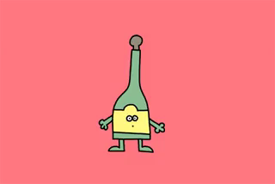
The collected juice is used for winemaking, while the crushed grapes are discarded.
The solution of juice - which is sugar and water mixed with nutrients - has yeast added and is left to sit.
Yeast converts the sugar into a chemical called ethanol. This is the chemical which makes a drink alcoholic - the process of using yeast to make ethanol is called fermentation.

Slide 15
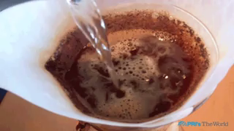
Ideally, wine should be a clear solution.
However, grape juice is not clear; instead it contains a large amount of fruit matter from the crushed grapes.
The juice is usually filtered to remove suspended solids, but small colloidal particles aren't removed by filtration.
To remove these, we need to use a chemical called a flocculant.

Slide 16
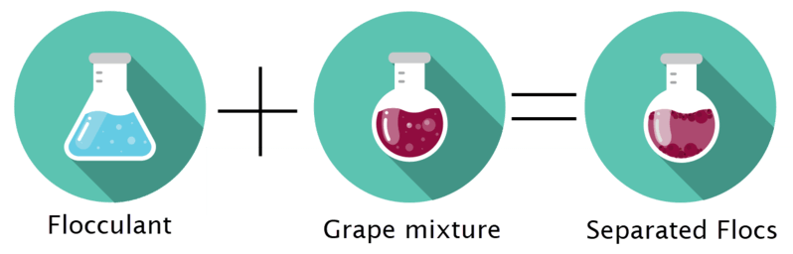
A flocculant is a chemical which causes colloidal particles to stick together and form large clumps called flocs.
They are usually added to remove colloidal particles from a liquid.
The flocs sink or float, allowing for easy removal. This process is also used in water purification, usually with substances like alum.

Slide 17
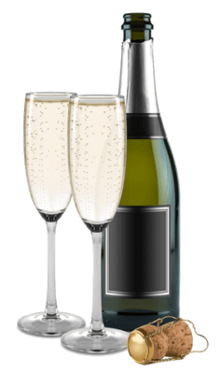
In winemaking, flocculation is called fining.
Egg whites, gelatin (used to make food jellies) and casein (found in milk) are all used to fine wine, bonding with suspended particles so that they float or sink. This process creates clear wines.

Slide 18
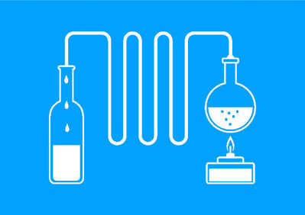
Wine and other alcoholic drinks can be distilled to create solutions of ethanol.
Ethanol has a lower boiling point than water, so when wine is boiled ethanol can be separated from the rest of the solution (along with some water).
The ethanol and water mixture can then be added back in to wines to fortify them (make them stronger). Wines such as aperas, sherries and muscats are all fortified in this way.

